Slide 1
Learning to Rank with Selection Bias in Personal Search
Mayank mahavar [15IT126]
Lokaksha B M [15IT124]
Manohar Madanu [15IT125]

Slide 2
Agenda
Introduction
Literature Survey
Outcome of Literature Survey
Motivation
Problem Statement
Objectives
Proposed Work
Conclusion
Timeline of Project
Individual Contribution
References

Slide 3
Introduction
We study the problem of learning-to rank from click data in personal search. Dierent from the majority of past click modeling work whose focus is on estimating the relevance for individual query-document pairs, we propose a novel selection bias problem in the context of the learning-to-rank from click data. The basic idea of the selection bias problem is that queries are under-sampled to dierent extents and thus biased when click data is collected to learn ranking functions. We propose several methods to estimate this bias. We begin with a global bias model and refine it to a segmented bias model. We show that such a segmented bias model gives rise to a general framework that denes a query-dependent bias, where every query (and its associated result set) can be associated with a potentially dierent bias model. This general query-dependent framework is especially powerful in the personal search scenario as it allows accurate bias estimation without explicit access to a large number of clicks for any given query-document pair. To the best of our knowledge, this is the first study that both proposes a theoretical framework for eliminating selection bias in personal search and provides an extensive empirical evaluation using large-scale live experiments.

Slide 4
Literature Review
Authors | Methodology | Advantages | Limitations
J. A. Aslam, E. Kanoulas , V. Pavlu , S. Savev , E. Yilmaz. | In order to investigate the effect of document selection on the ability of learning-to-rank algorithms to effectively and efficiently learn a ranking function, five different document selection methodologies, widely used in retrieval evaluation, are studied. | learning-to-rank algorithms are more robust to document selection methodologies than others. In particular, LambdaRank and RankNet seem to be more robust than Regression, RankBoost and Ranking SVM.
S. Buttcher , C. L. A. Clarke, P. C. K. Yeung , I. Soboro . | The evaluation measures referred to in this paper, such as MAP (mean average precision) and MRR (mean reciprocal rank), are used as defined by the implementation found in the trec eval evaluation toolkit3, the standard evaluation tool used at TREC. | Traditional evaluation measures used in Information retrieval are unable to deal with the problem of incomplete judgements. The bpref measure overcomes this limitation by ignoring unjudged documents. This approach works well for unbiased incomplete judgements, but does not properly address the problem of biased judgements. We found that bpref is not immune to incomplete and biased judgements. | Once the classifiers have been modified to generate probabilities instead of binary judgements, it is possible to combine their output with the probability values computed by the method proposed. It is conceivable that such a combination would result in even better predictions of document relevance — a direction that deserves further exploration.

Slide 5
Outcome of Literature Review
Learning to Rank Method Increases resultant document to display.
Learning to Rank uses user feedback to improve it`s scoring function.
Bias models can be used to normalized results.
Bias models affects performance and correctness
Bias models helps in generating better inverse propensity weights.

Slide 6
Issues and Challenges
Click through dataset
Pre processing
Calculating Tf-idf
Calculating Lossless function
Inverted Propensity weight
Bias factor

Slide 7
Motivation
Personalized search using Learning to rank with Selection Bias

Slide 8
Problem Statement
Retrieval of relevant documents for the query using learning to rank , Selection Bias to give more relevant document at first for personalised search.

Slide 9
Research Objectives
Preprocessing
Tf-idf
Calculation of Loss less function(Learning to rank)
Inverse Propensity Weight
Selection Bias models
Global Bias Model
Segmented Bias Model
Generalized Bias Model

Slide 10
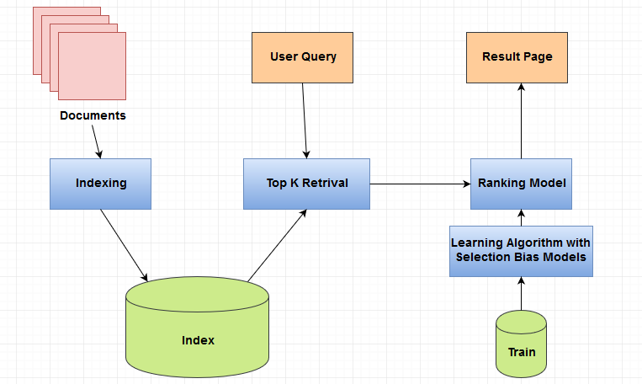
Proposed Model

Slide 11

Methodology
Learning to Rank
Inverse Propensity Weight
Global Bias Model
Segmented Bias Model

Slide 12
Work Done
Database Creation
We created database which will contain all the documents separately.
We used Reuters dataset that is why we have to first collect all the body content from each reuter file and store it as some document number.
We also stored which document belongs to which category.
Creating Database will decrease time of computation and accessing results.

Slide 13
Work Done
PreProcessing
We have took raw documents and then applied:
Splitting
Stemming
Stop Words Removal

Slide 14
Work Done
Term frequency
We have Created Vocabulary from bag of words.
We also calculated which term occurred how many time in which document.
Inverse Document Frequency
We have calculated idf for all the vocabulary terms separately.
TF-IDF
We have calculated TF-IDF value separately for future use.

Slide 15
Expected Results
User Query will get relevant documents in better order.
Different models will be compared and their performance will be evaluated.

Slide 16
Time Line of Project
Milestone | Estimated time of completion
Literature survey and dataset collection | 16 Feb
Pre Processing , TF-IDF | 26 Feb
Learning to Rank Score function | 4 March
Inverse propensity weight | 12 March
Selection Bias Models | 29 March

Slide 17
Individual Contribution
1.Mayank Mahavar :- Handling Database, Learning to rank Function, Global Bias Model
2. Lokaksha B M :- Pre Processing , Segmented Bias Model
3. Manohar Madanu :- TF-IDF , Generalized Bias Model
All members will equally contribute to work listed above.

Slide 18
References
(Other Related References)
Inverse Propensity Weight Explanation (http://www.rebeccabarter.com/blog/2017-07-05-ip-weighting/)
Learning To rank (https://wellecks.wordpress.com/2015/01/15/learning-to-rank-overview/)
Global Bias Model
Segmented Bias Model
Generalized Bias Model
Selected Base Paper
Learning to Rank with Selection Bias in Personal Search

